Slide 1
ONLINE ALGORITHM

Slide 2
OFFLINE ALGORITHM
Global information (past && future)
Design or compute the optimal solution with all information in hand

Slide 3
APPROXIMATION: CONCEPT
Competitiveness: concept
  online vs offline
  Input: an instance
  Output: a solution
  Worst-case bound: any instance at each time
    unknown OPT and any instance
    Approach the future？
  Is it possible？
  How good can it be？

Slide 4
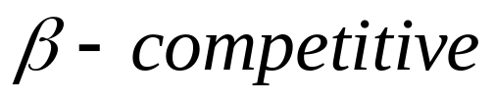

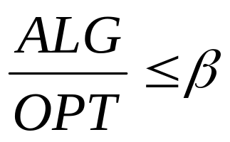
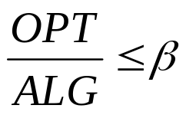
ONLINE ALGORITHM
Def.
:
an online algorithm that always output a solution ALG within a factor of OPT (the offline optimal solution)
No knowledge about future (time t).
--input arrives “piece by piece”
Using the local information (at time t or before time t) to design an algorithm.
--make decision on piece arrival
Past decisions cannot be revoked
Evaluation
  worst case
  expected
Minimization:
Maximization:

Slide 5

EXAMPLE
Competitiveness: example
  Problem: poker game
    you vs me
    range[1,13]
    I release n pokers online
    u draw k times (e.g. n=10,k=3)
    Goal: gain as much as possible
  Alg
  Adversary
Q: alg?
competitiveness?
how good possible?

Slide 6
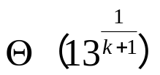
APPROXIMATION: CONCEPT
Competitiveness: example
  Problem: poker game
    you vs me
    range[1,13]
    I release n pokers online
    u draw k times (e.g. n=10,k=3)
    Goal: gain as much as possible
  Alg
  Adversary

Slide 7

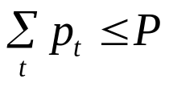
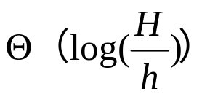



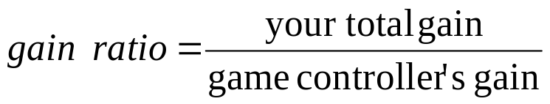
APPLICATION FROM RESEARACH
Throughput in wireless communication:
  Online sequence:
  Power budget:
  Time slot t: allocate
  Maximize:
  +battery capacity
  ALG: R=r^{k+1}; r^1 r^2 r^3 r^k

Slide 8
SCHEDULING UNIT JOBS TO MAXIMIZE THROUGHPUT
Jobs:
  all have processing time (length) = 1
  release time r_{j}
  deadline d_{j}
  weight w_{i}
Goal: compute a schedule that maximizes the total weight of completed jobs (that meet their deadlines)
In Graham’s notation 1|r_{j},p_{j}=1|∑w_{j}U_{j}
  _{all integer}

Slide 9



MOTIVATION: ONLINE PURCHASE, PACKET SCHEDULING
buffer
Buffer
manager
incoming
packets
4, 3
2, 1
transmit
5, 4
5, 1
4, 3
?
drop
weight
deadline

Slide 10
Example: online purchase
0 1 2 3 4 5 6 7
7
1
9
2
11
3
8
4
jobs
5
5
6
13
4
7
8
10
14
9
10
10
5
11
time slots

Slide 11
Example:
0 1 2 3 4 5 6 7
7
1
9
2
11
Schedule with time
= 7+9+11+5+4+10+5
= 51
3
8
4
5
5
6
13
4
7
Can we do better?
8
10
14
9
10
10
5
11
1
2
3
5
7
10
11

Slide 12
Example:
0 1 2 3 4 5 6 7
7
1
9
2
11
3
Schedule with weight
= 9+11+13+10+14+10+5
= 72
8
4
5
5
6
13
4
7
Can we do even better?
8
10
14
9
10
10
5
11
2
3
6
8
9
10
11

Slide 13
Q: OFFLINE ALGORITHM？

Slide 14
OFFLINE ALGORITHM:
MAXIMUM WEIGHT MATCHING IN BIPARTITE GRAPHS

Slide 15
OFFLINE ALGORITHM:
MAXIMUM WEIGHT MATCHING IN BIPARTITE GRAPHS Q: HOW TO？

Slide 16
OFFLINE ALGORITHM:
A: MATCHING？
Construct graph G:
Compute max-weight
matching in G
Matched vertices on
left= scheduled jobs
Matched vertices on
right = schedule times

Slide 17


OFFLINE ALGORITHM:
MAXIMUM WEIGHT MATCHING IN BIPARTITE GRAPHS
Construct graph G:
Compute max-weight
matching in G
Matched vertices on
left= scheduled jobs
Matched vertices on
right = schedule times
jobs
time slots
1
0
1
2
.
.
.
j
.
.
.
.
.
.
.
.
.
.
.
.
n

Slide 18
ONLINE PROBLEM
This is time-online,
not list-online.
Different model
than list scheduling !
Jobs arrive at release times
Online algorithm decides which jobs to schedule without the knowledge of the jobs released in the future
Algorithm A is R-competitive if for each instance
weight of the optimum schedule
≤ R · weight of A’s schedule
for randomized algorithms,
expected # jobs

Slide 19
ALGORITHM ED: AT EACH STEP SCHEDULE THE EARLIEST-DEADLINE AVAILABLE JOB.
Q: if all weights are equal (we maximize the number of completed jobs),
A: ED computes the optimum solution.
Hint: An exchange argument: take any schedule and convert it into an ED schedule, step by step, without decreasing the number of completed jobs.
Corollary: For any weights, if X is a feasible set of jobs then we can schedule the jobs in X according to the earliest-deadline policy.
In particular, we can assume: in an optimal schedule, if at some time t, jobs i and j are pending, d_{i} < d_{j} and j is executed at time t then i will not be executed in the future (the ED property)

Slide 20
Q: what is the key difficulty
of the problem? Dilemma
0 1 2
1
1
u > 1
2

Slide 21
Q: what is the key difficulty
of the problem? Dilemma
A: weight vs time-critical
0 1 2
1
1
u > 1
2

Slide 22
Dilemma: execute an urgent
light job or heavy but not
urgent job?
0 1 2
1
1
u > 1
2
0 1 2
execute 2
1
execute 1
1
u > 1
0 1 2
2
1
1
So the worst-case ratio is
R = min{ (u+1)/u, 2u/(u+1) }
R = (u+1)/u
u > 1
2
u
0 1 2
1
1
To prove a lower bound,
maximize R, equalize:
(u+1)/u = 2u/(u+1)
we get
u = 1 + sqrt(2)
So R = sqrt(2) ≈ 1.41
u > 1
2
u
R = 2u/(u+1)

Slide 23
Dilemma: execute an urgent
light job or heavy but not
urgent job?
0 1 2
1
1
u > 1
2
0 1 2
execute 2
1
execute 1
1
u > 1
0 1 2
2
1
1
R = (u+1)/u
u > 1
2
u
0 1 2
1
1
u > 1
2
u
R = 2u/(u+1)

Slide 24
Dilemma: execute an urgent
light job or heavy but not
urgent job?
0 1 2
1
1
u > 1
2
0 1 2
execute 2
1
execute 1
1
u > 1
0 1 2
2
1
1
Q: So the worst-case ratio is?
R = (u+1)/u
u > 1
2
u
0 1 2
1
1
Q: To prove a lower bound,
maximize R?
u > 1
2
u
R = 2u/(u+1)

Slide 25
Dilemma: execute an urgent
light job or heavy but not
urgent job?
0 1 2
1
1
u > 1
2
0 1 2
execute 2
1
execute 1
1
u > 1
0 1 2
2
1
1
So the worst-case ratio is
R = min{ (u+1)/u, 2u/(u+1) }
R = (u+1)/u
u > 1
2
u
0 1 2
1
1
To prove a lower bound,
maximize R, equalize:
(u+1)/u = 2u/(u+1)
we get
u = 1 + sqrt(2)
So R = sqrt(2) ≈ 1.41
u > 1
2
u
R = 2u/(u+1)

Slide 26
We just proved:
Theorem: No online algorithm for unit job scheduling has
competitive ratio better than sqrt(2) ≈ 1.41.
Can we do better?
Theorem: No online algorithm for unit job scheduling has
competitive ratio better than φ ≈ 1.618.
φ = golden ratio = solution of x² = x+1.
Proof: not easy.

Slide 27
7
ALG: At each step schedule a job
with maximum value.
1
9
2
11
3
8
4
5
5
6
13
4
7
8
10
14
9
3
2
6
9
5
7
Q: Show that the competitive ratio of
ALG-Greedy is ≥ 2

Slide 28
7
ALG: At each step schedule a job
with maximum value.
1
9
2
11
3
8
4
5
5
6
13
4
7
8
10
14
9
3
2
6
9
5
7
Q: Show that the competitive ratio of
ALG-Greedy is ≥ 2
u
1
u+1
2
R = (2u+1)/u → 2

Slide 29
Theorem: Greedy is 2-competitive
Proof: “Charge” jobs in optimal schedule to Greedy’s schedule G
such that each job j in G receives charge at most 2w_{j}
Total charge ≤ 2 times the weight of G
⇒ optimal weight ≤ 2 weight of G
⇒ Greedy is 2-competitive
Charging scheme: let j be a job executed at time t
Rule 1: if j executed before time t in G, charge w_{j} to j
Rule 2: Otherwise, charge w_{j} to the job executed at time t in G
t
t
Q: There must be a
job here?
G
G
j
j
j
opt
opt
Existance & larger

Slide 30
Theorem: Greedy is 2-competitive
Proof: “Charge” jobs in optimal schedule to Greedy’s schedule G
such that each job j in G receives charge at most 2w_{j}
Total charge ≤ 2 times the weight of G
⇒ optimal weight ≤ 2 weight of G
⇒ Greedy is 2-competitive
Charging scheme: let j be a job executed at time t
Rule 1: if j executed before time t in G, charge w_{j} to j
Rule 2: Otherwise, charge w_{j} to the job executed at time t in G
t
t
Q: There must be a
job here?
A: j
is pending at t
G
G
j
j
j
opt
opt
Existance & larger

Slide 31
Claim: each job k in G gets a charge ≤ 2w_{k}.
k gets at most 2 charges (one for each rule)
k
G
Charge from Rule 1 is = w_{k}
j
k
Charge from Rule 2 is ≤ w_{k} because
j is pending and Greedy executes the
heaviest pending job, so w_{j} ≤ w_{k}
opt
the charge to k is ≤ 2w_{k}
Greedy is 2-competitive

Slide 32
TOPICS IN THIS SEMESTER
Introduction to ALG
Divide and conquer I: sorting
Divide and conquer II
Greedy I
Greedy II
Dynamic programming I
Dynamic programming II
Game I: equilibrium
Game II: auction
Approxi I
Stable concept
Approxi II
NP-complete reduction
Online I
预备知识
递归与分治
动态规划
贪心算法
回溯法?
分支界限法?
概率算法
线性规划与网络流
NP-完全理论与近似算法

Slide 33
EXAMPLE FROM OUR RESEARCH
Observe & attack the problems

Slide 34
EXAMPLE FROM OUR RESEARCH
Observe & attack the problems
EX1: Power saving problem in data center
online min active time for data center
  1 machine with state active/idle
  n tasks: each task j with
    Processing time p_j
    Release time r_i
    Deadline d_i
  Allocate the tasks with intersection
  Allocate when arrival
  Obj: min total active value
Q: offline algorithm？
Q: online algorithm？
Q: bad example？
  open for you: how to make ‘fast’ offline/online decision
Prior results： ours
offline： 2-approxi→OPT
online： not known→4-comp

Slide 35
EXAMPLE FROM OUR RESEARCH
Observe & attack the problems
Ex2: Budget feasible procurement/crowdsourcing/auction
  Deal with budget
  To deal with cheatings:
  Deal with efficiency
Original Problem: budget feasible with P
  N items with value v_i
  N bidders with cost c_i
  Sealed bid b_i
  Payment p_i
  Utility u_i=p_i-c_i if choosed
  Budget feasible <=P
  Q: How to stimulate the bidders bid his true cost c_i
Truthfulness？
Prior results：
Matching/capacity: unknown

Slide 36
BUDGET FEASIBLE AUCTION
Budget feasible procurement
Original Problem: budget feasible with P
  N items with value v_i
  N bidders with cost c_i
  Sealed bid b_i
  Payment p_i
  Utility u_i=p_i-c_i if choosed
  Q: How to stimulate the bidders bid his true cost c_i
Truthfulness？
Simpler Problem: k item selection with all v_i=1
  How to choose？
  How to pay？
A: choose proper k’
  Pay what？ P/k’, c_{k’+1}
  Why truthful
  2-approximation
Q: Show the proof？

Slide 37
Budget feasible procurement
Simpler Problem: k item selection with all v_i=1
  How to choose?
  How to pay?
A: choose proper k’
  Pay what? P/k’, c_{k’+1}
  Why truthful?
  2-approximation
Q: Show the proof？
General case
  [Extended reading: Budget feasible mechanisms, 2010]

Slide 38
EXAMPLE FROM OUR RESEARCH
Observe & attack the problems
Ex3: Throughput in wireless communication:
  Online sequence:
  Power budget:
  Time slot t: allocate
  Maximize:
  +battery capacity
  [Extended reading: online throughput]
Prior results： ours
T-competitive,pseudo-online → optimal

Slide 39
THANK U!
→POTENTIAL FUNCTION METHOD

Slide 40
THANK U!
→POTENTIAL FUNCTION METHOD

Slide 41




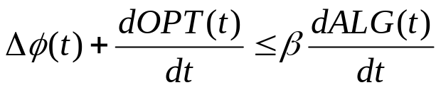
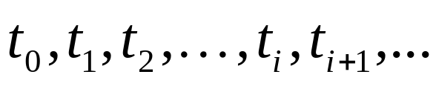
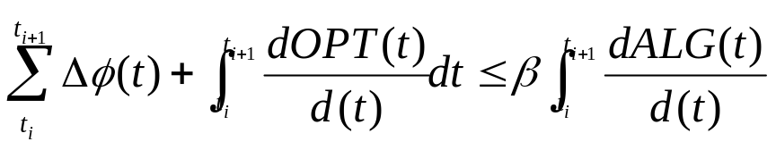
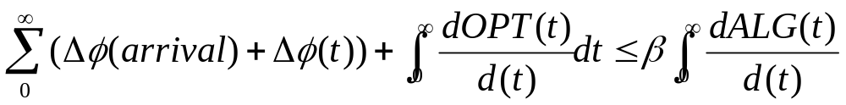


AMORTIZED ANALYSIS: POTENTIAL FUNCTION METHOD
An online algorithm is
if there exists a function satisfying
  C1. Boundary condition: ,
  C2. Arrival condition:
  C3. Working condition:
Brief proof:

Slide 42
Different proof: Define potential funtion
Φ: {configurations} → {non-negative reals}
such that initially Φ = 0 and in each move
2·(Greedy’s gain) ≥ (opt gain) + ΔΦ
potential change
in this move
potential change
in move 1, etc
This is sufficient by amortization:
In step 1 2·(Greedy’s gain) ≥ (opt gain) + Δ₁Φ
In step 2 2·(Greedy’s gain) ≥ (opt gain) + Δ₂Φ
In step 3 2·(Greedy’s gain) ≥ (opt gain) + Δ₃Φ
…. ….
In step n 2·(Greedy’s gain) ≥ (opt gain) + Δ_{n}Φ
In total 2·(total Greedy’s gain)
≥ (total opt gain) + Φ_{final} - Φ_{initial}
≥ (total opt gain)

Slide 43
At a given time, let
G = set of jobs pending by Greedy
Q = set of jobs pending in the optimum schedule
Φ = w(Q-G)
Recall that we need
(*) 2·(Greedy’s gain) ≥ (opt gain) + ΔΦ
Let j = job executed by opt
k = job executed by Greedy
(if Greedy does not have a pending job, assume w_{k} = 0)
If j ∈ Q-G then ΔΦ ≤ -w_{j} + w_{k} and (*) holds because
2· w_{k} ≥ w_{j} + (-w_{j} + w_{k}) ≥ w_{j} + ΔΦ
Else, j ∈ Q∩G, so j is pending for Greedy, so w_{k} ≥ w_{j} and
ΔΦ ≤ w_{k} and (*) holds because
2· w_{k} ≥ w_{j} + w_{k} ≥ w_{j} + ΔΦ

Slide 44
The 2-Bounded Case: for each j, d_{j} ≤ r_{j}+2.
(A job released at time t expires at time t+1 or t+2).
Algorithm Balance: At each time t,
e = heaviest job with d_{j} = t+1
h = heaviest job with d_{j} = t+2
If w_{h} ≥ φ·w_{e}, execute h
else, execute e
7
1
9
2
11
3
8
4
9
5
19
6
14
7
17
8
1
6
5
8
Theorem: Algorithm Balance is φ-competitive.

Slide 45
Proof: “Charge” jobs in optimal schedule to Balance’s schedule B
such that each job j in G receives charge at most φw_{j}
Total charge ≤ φ times the weight of G
⇒ optimal weight ≤ φ weight of G
⇒ Balance is φ-competitive
Charging scheme: let j be a job executed at time t
Rule 1: if j executed at time t or t-1 in G, charge w_{j} to j
Rule 2: Otherwise, charge w_{j} to the job executed at time t in G
t
t
B
B
j
j
j
opt
opt

Slide 46
Claim: each job k in G gets a charge ≤ φw_{k}.
k gets at most 2 charges (one for each rule)
k
B
Charge from Rule 1 is = w_{k}
k
opt
k
Charge from Rule 2 is ≤ φw_{k} since j is pending
and Balance would not execute k if there is
another pending job j with w_{j} > φw_{k}
B
j
opt
k
If there are both charges, then d_{k} = t+2
so w_{k} ≥ φw_{j} and the charge is
d_{k}+d_{j} ≤ d_{k} + w_{k}/φ
= (1+1/φ)w_{k}
= φw_{k}
because 1+1/φ = φ
B
j
k
opt

Slide 47
IMPROVING RATIO USING RANDOMIZATION?
Idea: Choose a job to execute at random, using appropriate probabilities
1
1
u > 1
2
Prob = p
Suppose the instance is either {1,2} or {1,2,3} with r₃=1 w₃=u
1
1
u
Prob = 1-p
2
1
1
1
1
u
u
{1,2}
2
2
{1,2,3}
{1,2,3}
1
1
{1,2}
u
2
1
1
u
1
1
3
u
u
2
2
u
3
Intuition: p should be roughly u/(u+1)

Slide 48
RANDOMIZED COMPETITIVE ALGORITHMS
Algorithm can make random choices at each step
Algorithm A is R-competitive if for each instance
weight of optimum schedule
≤ R · Exp[weight of A’s schedule]
Expected value, with respect to A’s random choices

Slide 49
EXERCISE: WHAT IS THE COMPETITIVE
RATIO FOR U=2 AND P=1/3?
1
1
u > 1
2
Prob = p
1
1
u
Prob = 1-p
2
1
1
1
1
u
u
{1,2}
2
2
{1,2,3}
{1,2,3}
1
1
{1,2}
u
2
1
1
u
1
1
3
u
u
2
2
u
3
Hint: compute the ratio for both instances and take the maximum
Exercise 2: is 1/3 optimal (for these two instances)?
Exercise 3: for any u, what is the optimal probability?

Slide 50
1.58-COMPETITIVE RANDOMIZED ALGORITHM
Algorithm RMix. At a give time step,
consider only significant jobs (with
no heavier jobs in front of them)
weight
h₂
h₁
h_{k}
...
h₃
h₁ - heaviest pending job
h_{i+1} - heaviest pending job j with w_{j} > λw(h_{i}) and d_{j} < d(h_{i})
Schedule h_{i} with probability δ_{i}
λw(h₁)
deadlines
and δ_{i} will be determined later
to optimize the ratio

Slide 51
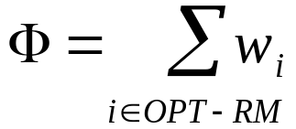
ANALYSIS:
RM - set of pending jobs for RMix
OPT - pending jobs in the optimal schedule (wlog optimal schedule is ED)
A
B
Define potential
t
B
A
OPT
Total weight of jobs pending
in optimal schedule but not in
Rmix’s schedule
RM

Slide 52
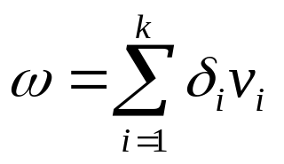
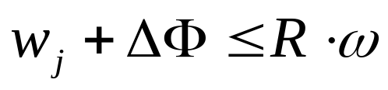
OPT
Denote v_{i} = w(h_{i}) and v_{k+1}=λw(h₁)
The expected gain is
RM
Job arrivals and expirations do not increase the potential
Suppose the optimal schedule executes j. It is
then enough to prove that

Slide 53
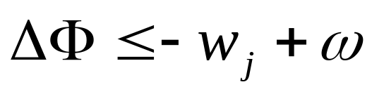
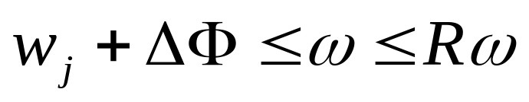
CASE 1: J ∈ OPT - RM
Recall: j = job
executed by opt
With probability δ_{i}
OPT
h(i)
j
RM
so

Slide 54
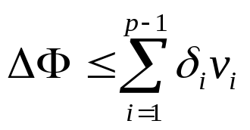
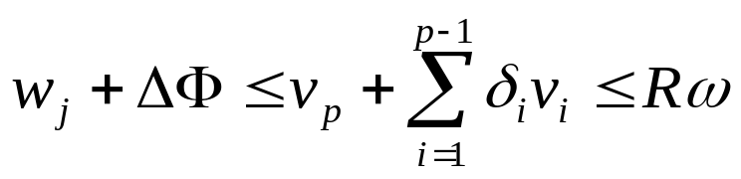
CASE 2: J ∈ AD ∩ RM
weight
h₁
h₂
h_{k}
...
h₃
λw(h₁)
Then w_{j} ≤ v₁ as j ∈ X
Let 1 ≤ p ≤ k+1 be the largest index s.t. w_{j} ≤ v_{p}
deadlines
The expected potential change is
It remains to find R for which

Slide 55
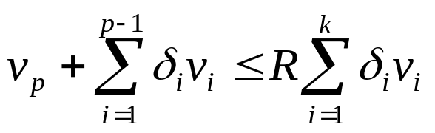
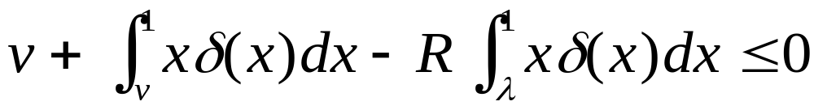
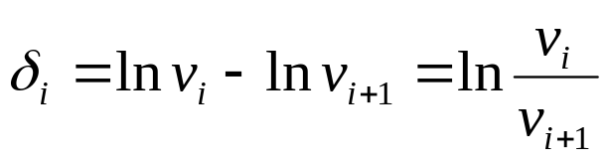
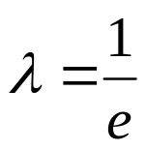
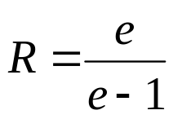
?
Denote v = v_{P}
We can assume v₁ = 1 (rescale all weights)
?
Choose δ(x), λ, so that left hand side is independent
of v (solve differential equation). This yields:
Theorem: Algorithm Rmix is e/(e-1)-competitive.
e/(e-1) ≈ 1.58

